Slide 1
Application Bootcamp
Presented by: The Penncrest High School Guidance Department

Slide 2
Agenda
Admissions Overview / NACAC Guidelines
College Application Instruction / Demonstration
Senior Timeline
What do counselors send with applications?
Naviance
Financial Aid
Wrap up and questions

Slide 3
Who’s Journey Is This? Understanding the Parent’s role
Director or consultant
Don’t rush in to save students from appropriate feelings of fear, anxiety, and uncertainty
Manage your own anxiety
Give students room to feel, talk, and question

Slide 4
Senior Year Parent Thinking Points
____ Help your student find a college / post high school plan that fits their needs and aspirations.
____ You should help your child understand the options and possibilities and help them to choose a post high school pathway but not dictate choice.
____ The process of applying to college or choosing an alternate plan can be stressful for all concerned.
____ The process of applying to colleges can be exciting and inspirational to all concerned.

Slide 5
Senior Year Timeline
https://bigfuture.collegeboard.org/get-in/applying-101/timeline-12-grade

Slide 6
The Search Continues…
Everyone is on their own timeline
Upcoming opportunities to explore colleges: College representatives visit Penncrest throughout the year. Last year over 160 different colleges visited Penncrest. College rep visits are posted in the “What’s New” section of the Naviance student’s homepage.
NACAC Virtual College Fair on Sunday, September 10, 2023
NACAC In-Person College Fair Saturday, October 14, 2023
Senior Parent / Financial Aid Night, tbd
Planned visits to college campuses. Visits are excused absences.

Slide 7
How do I apply to college?
Common Application
Coalition Application
Institution Applications
Self-Report Applications: Penn State, University of Pittsburgh, Temple, and University of South Carolina

Slide 8
The College Application Process Rights & Responsibilities
Students are not required to respond to colleges with a “yes” or “no” until May 1, 2024
The only exception is for students who are applying via Early Decision I or Early Decision II
Make a deposit to one school only
Be prepared for colleges to respond with: Admit, Deny, Defer, Waitlist, Summer / January Admit

Slide 9
College Admissions / Special Programs
Students who are considering applying to various specialized programs are encouraged to review application requirements and deadlines carefully.
Nursing programs may have different deadlines than other programs
Students applying for creative and performing arts programs may have specialized requirements ( portfolio, auditions, etc. ).

Slide 10
Notes:
Check college websites to clarify admissions practices

Slide 11
Early Decision Is It The Right Decision For You?
Take A Closer Look At Early Decision

Slide 14
Early Decision vs. Regular Decision Acceptance Rates
Early Action vs. Regular Decision Acceptance Rates

Slide 15
Naviance: College Applications
A Guide To Application Management

Slide 16
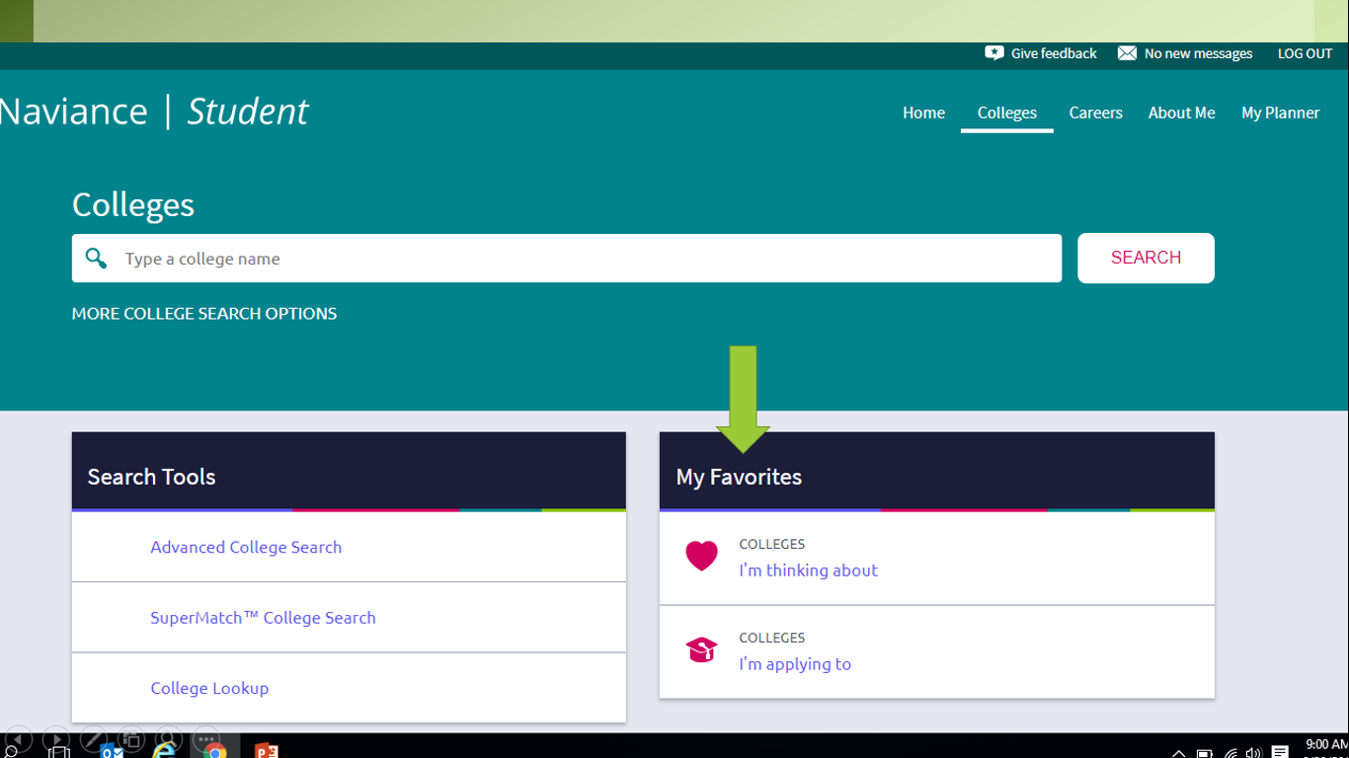

Slide 17
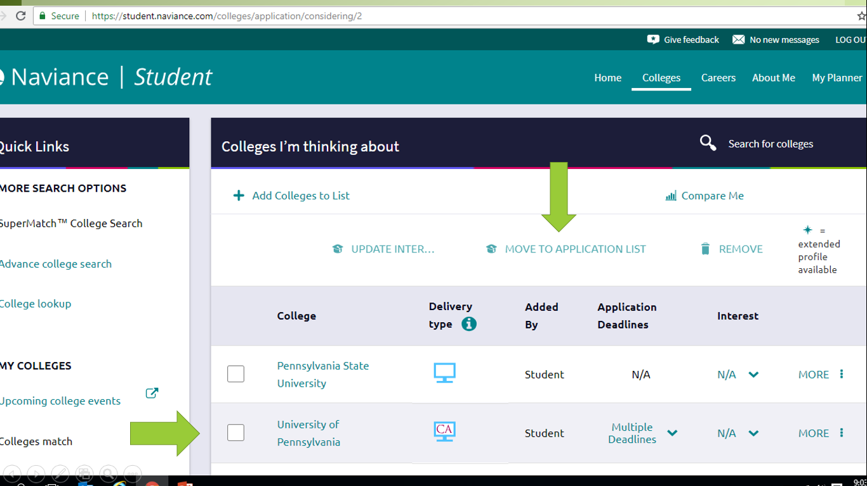

Slide 18
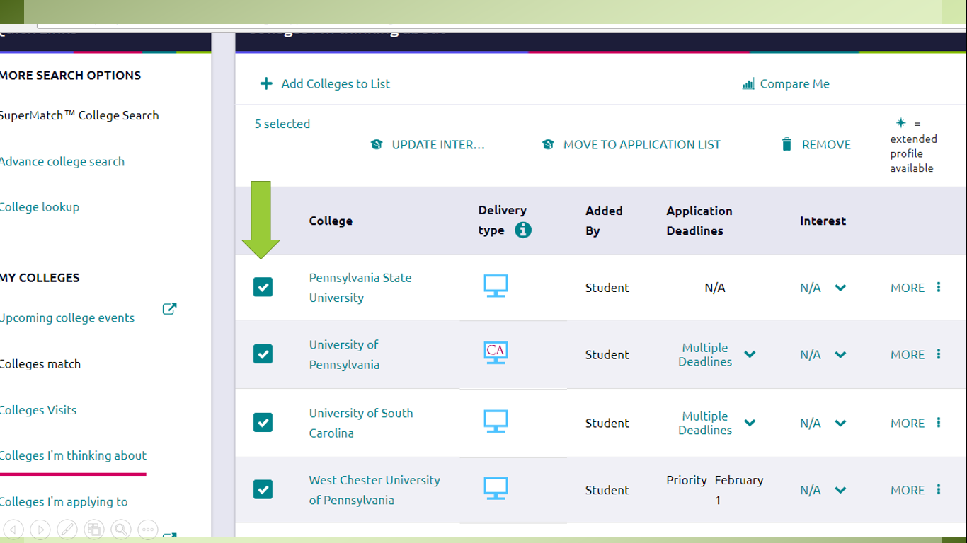

Slide 19
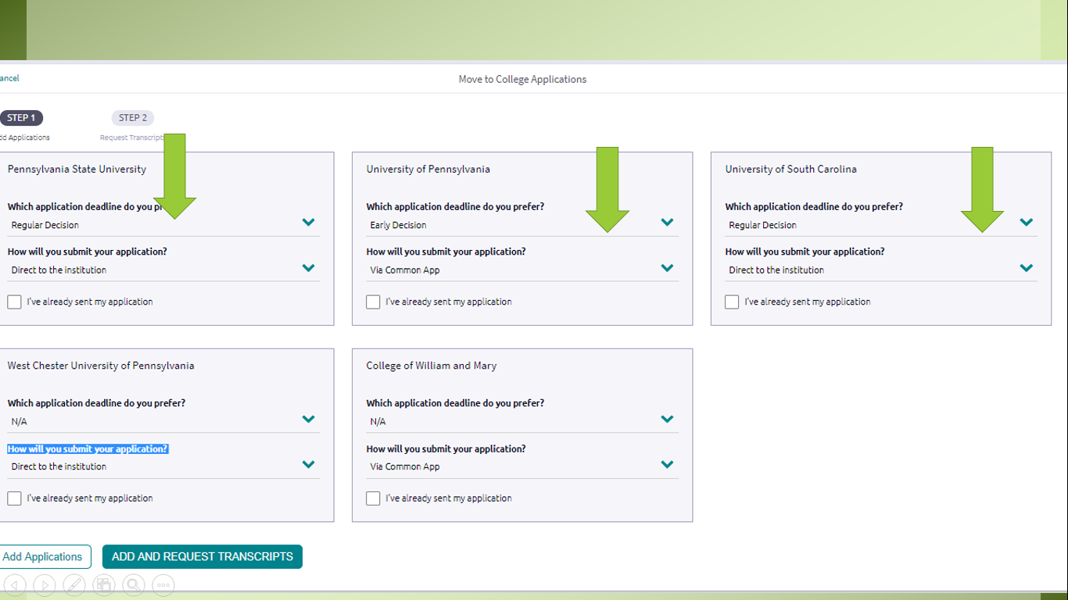

Slide 20
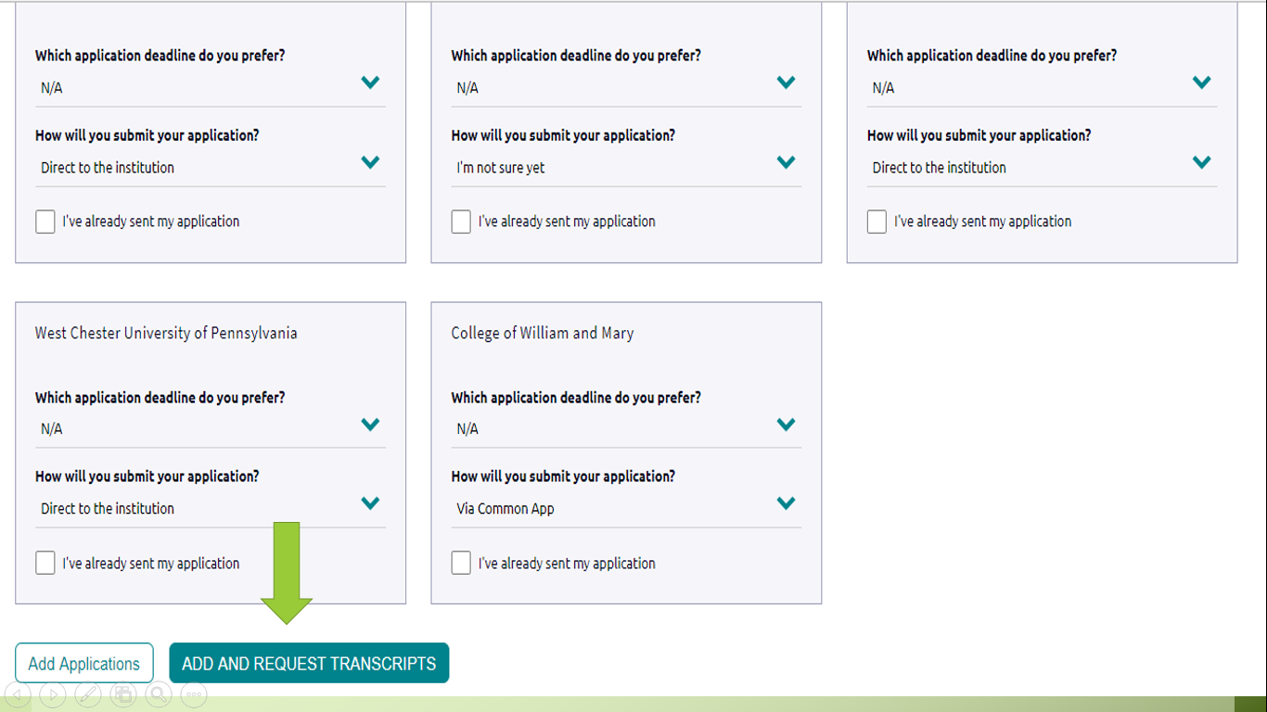

Slide 21
The Common Application
The Common Application is used by over 900 colleges and universities
Not all colleges use the Common Application. Students are advised to consult the admissions websites for each school under consideration for exact details.
Not all students need to create a Common Application account

Slide 22
Creating a Common Application Account
Complete the Personal Demographic information section.
Complete the Education section.
Add a college.
Complete your FERPA waiver ( Under “My Colleges” tab in Naviance tab Recommenders and FERPA)
Why should I waive my rights?

Slide 23
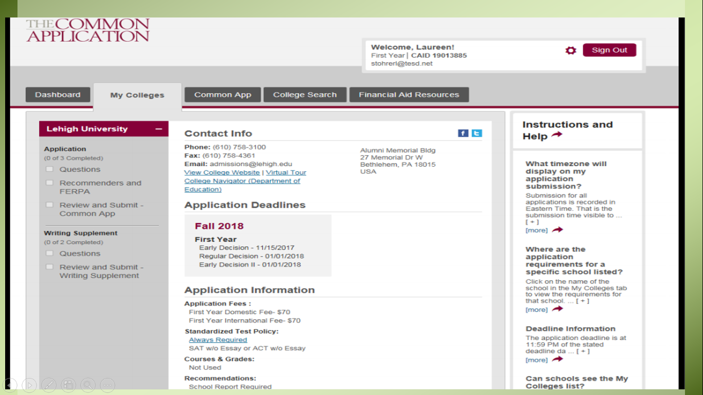

Slide 24
Common App / FERPA Waiver
In order to sign off on the Common App FERPA Waiver & Authorization on the Common App, students will need to add at least one college to your Common Application list and complete the Education section including your current school and counselor information.
THEN go into the college that you have listed in the Common App and you will see to the side the choice of “Recommenders and FERPA”

Slide 25
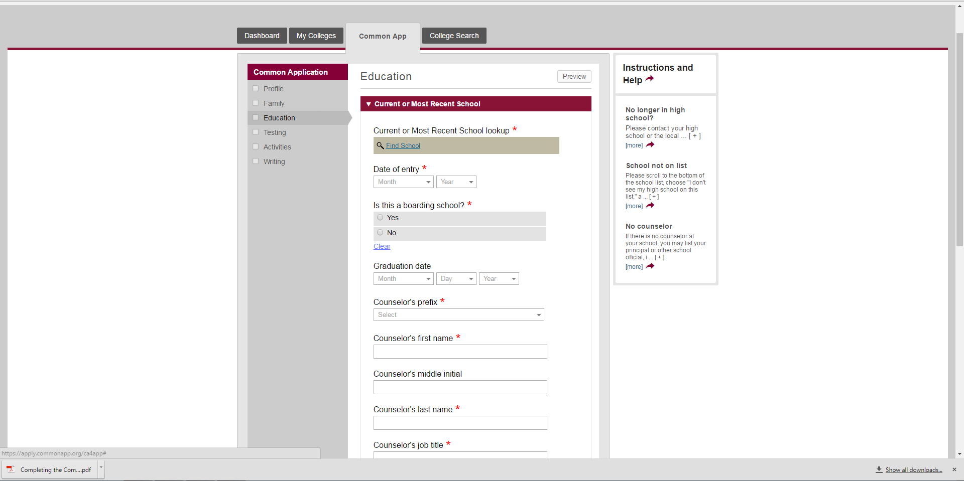

Slide 26
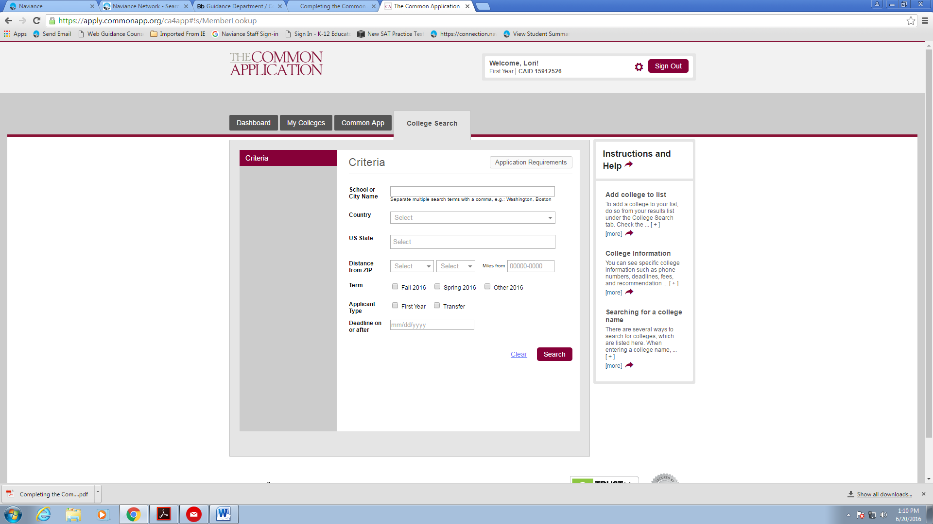

Slide 27
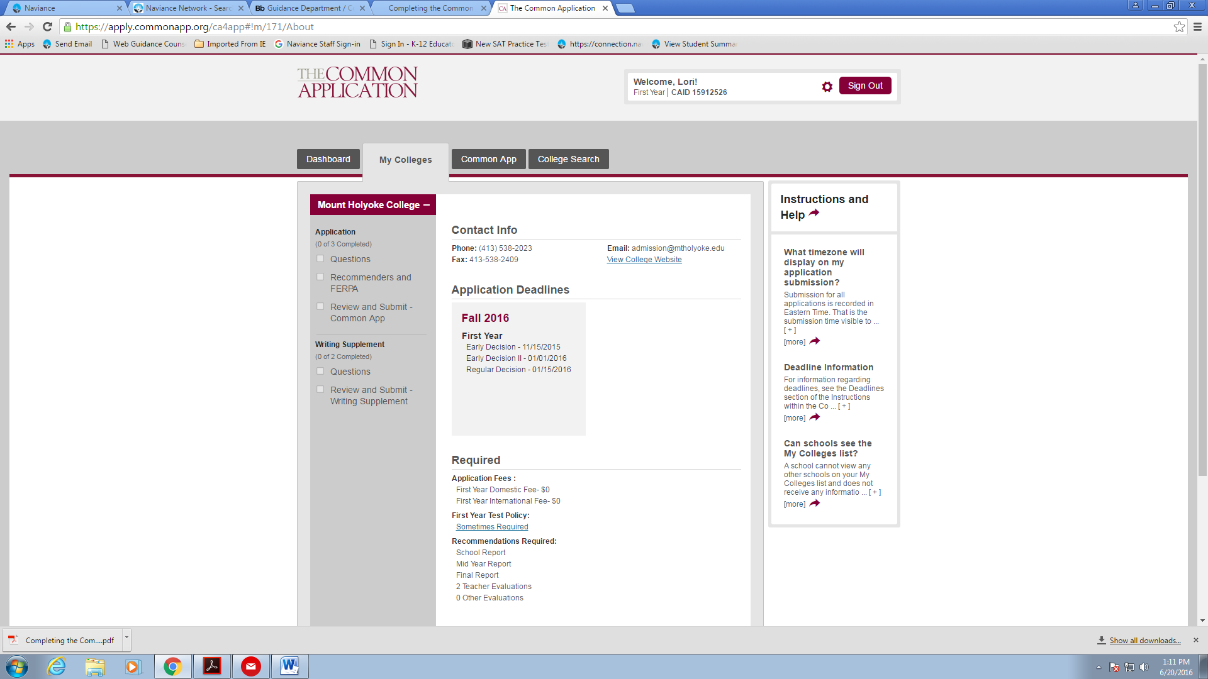

Slide 28
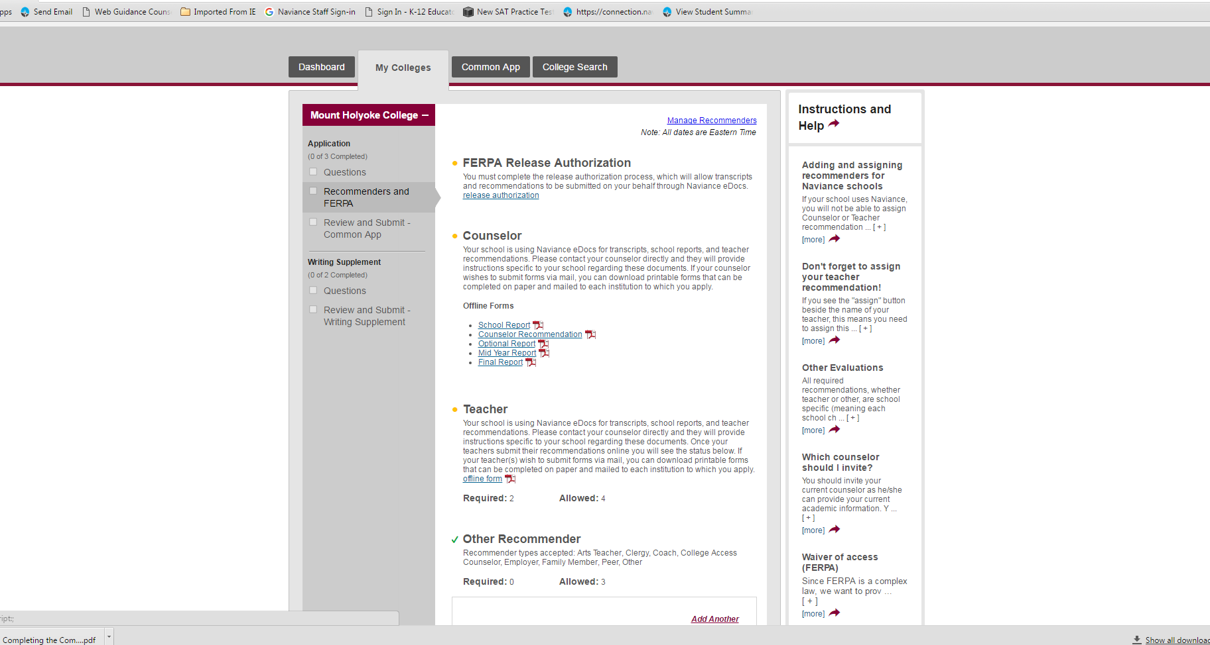

Slide 29
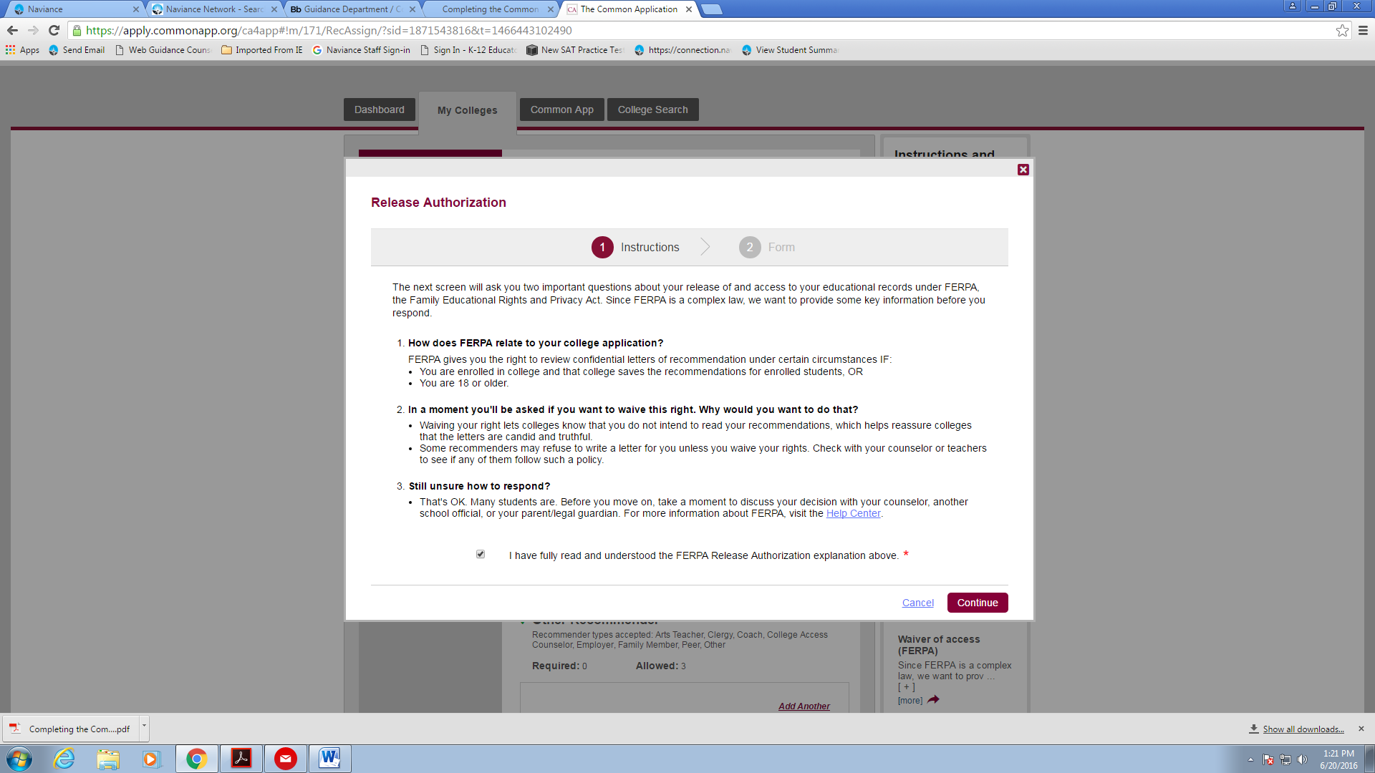

Slide 30
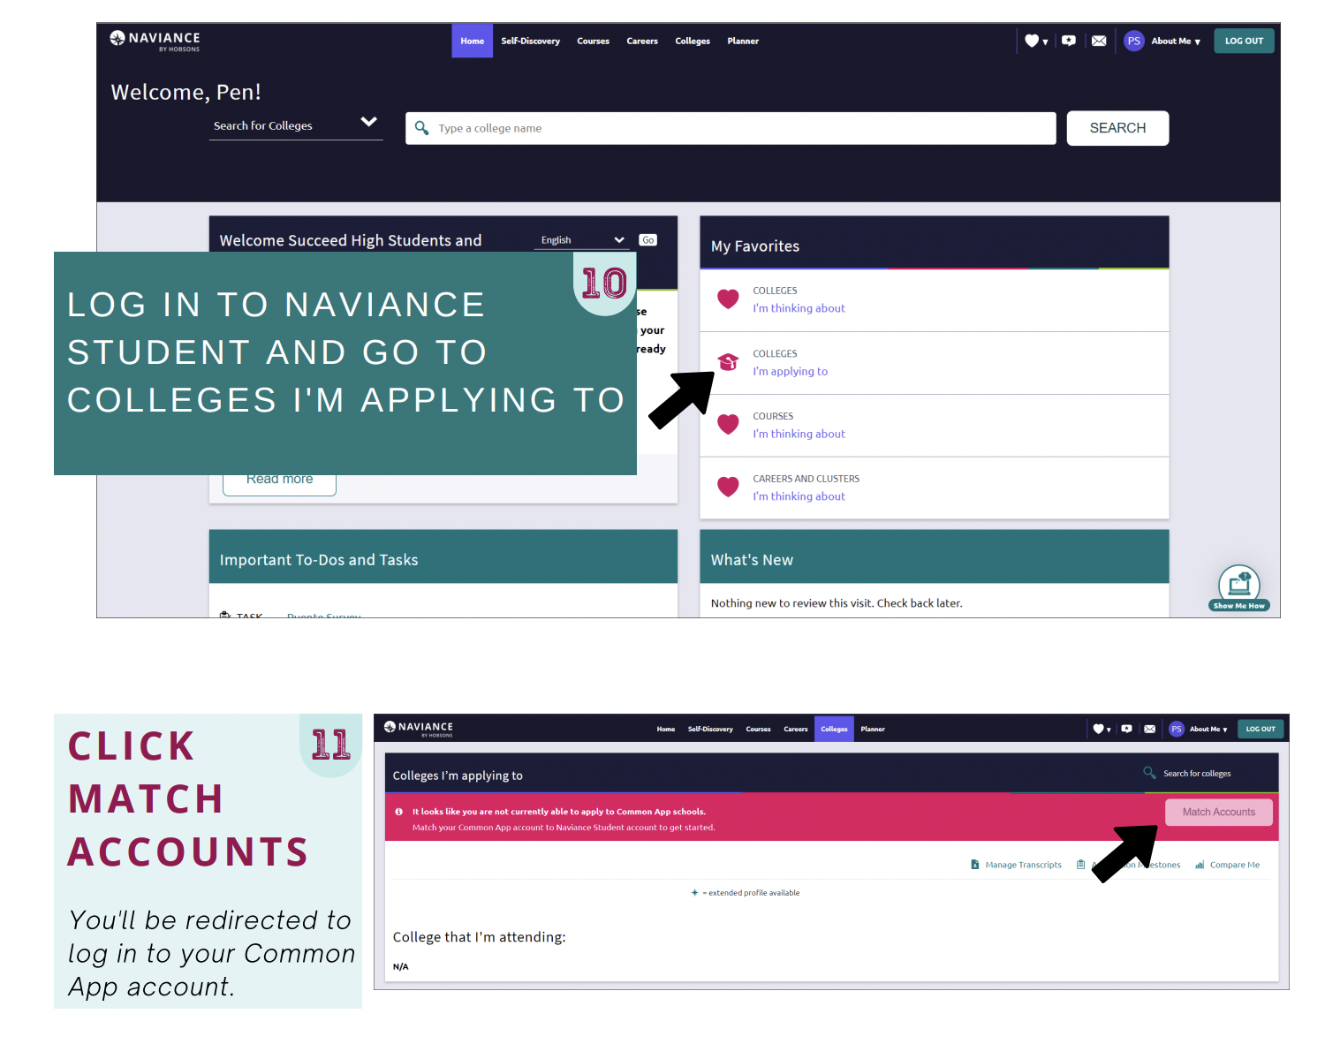

Slide 31
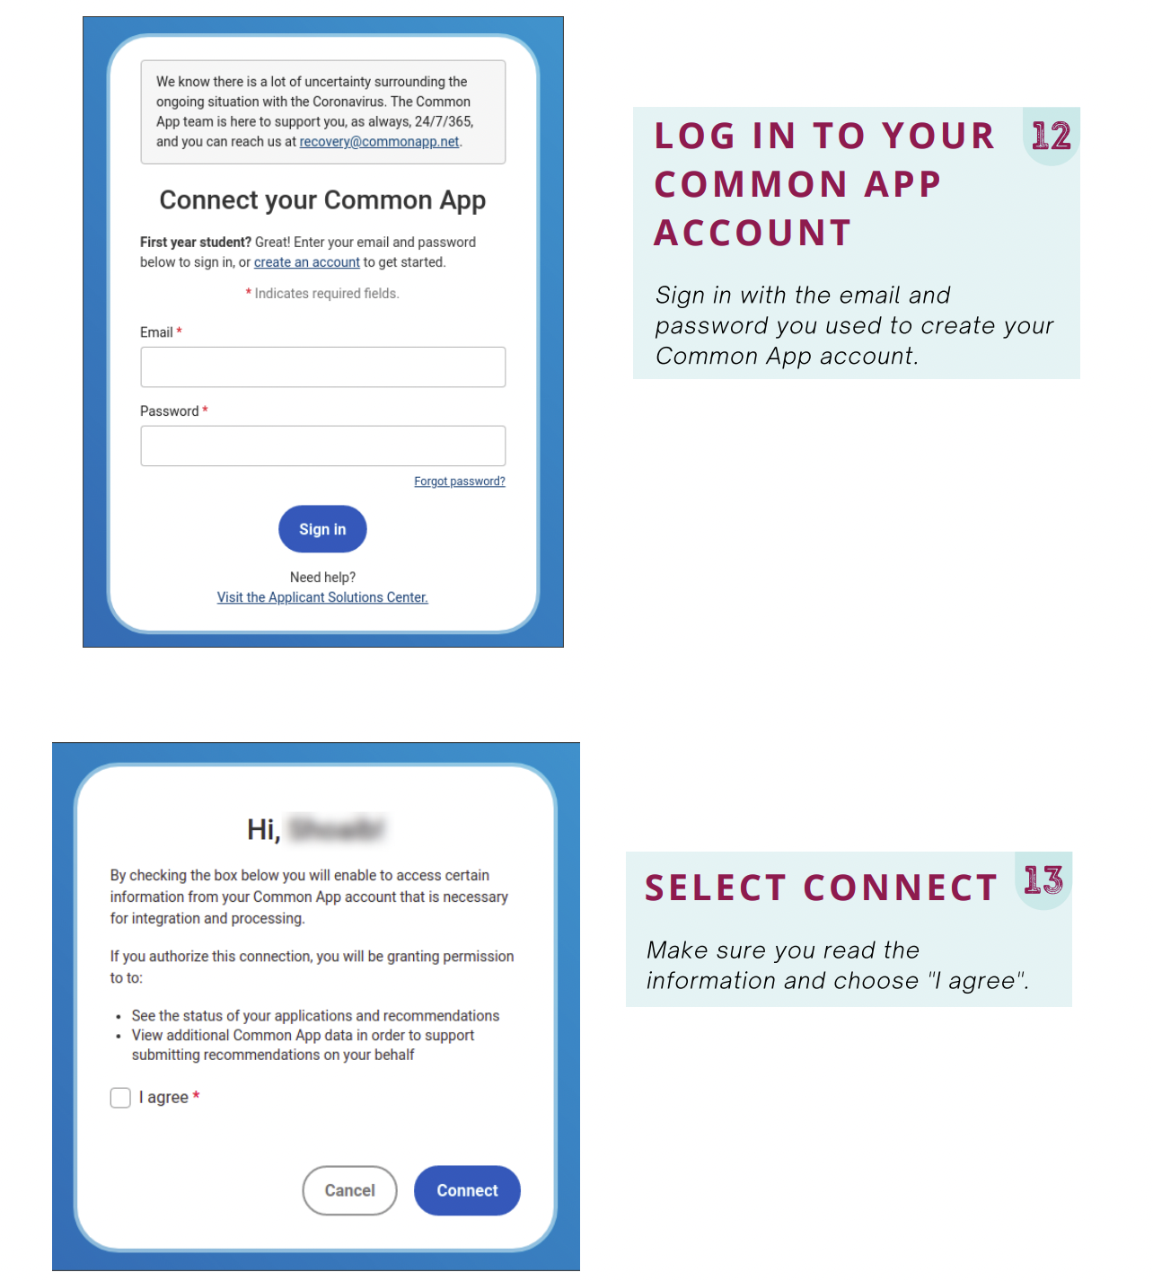

Slide 32
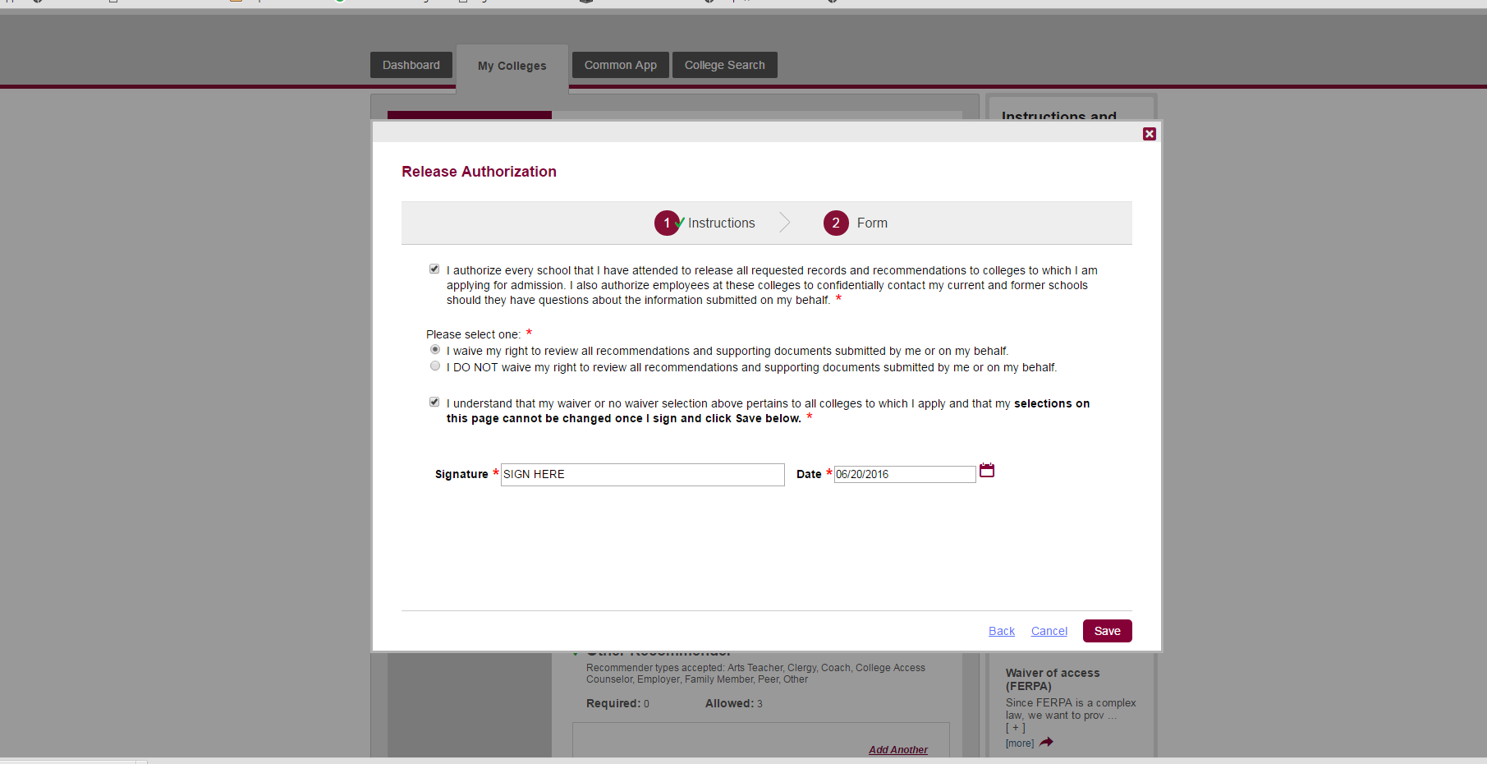

Slide 33
Teacher Recommendations
Add teachers in Naviance, under “Colleges” tab, under “Letters of Recommendation”
Remember to communicate your first deadline date with your teachers. For rolling admissions schools allow your teachers 14 days to submit.
Please select “All Schools” so that we can send your materials everywhere.
Note- Not all schools require teacher recommendations.
No need to add teachers to the Common App

Slide 34
Self-Reported Academic Record
Applicants submit their high school record without submitting a transcript from Penncrest

Slide 35
Self Reported Academic Record (SRAR)
Several colleges and universities use a version of the SRAR to expedite the college application process.
These schools include but are not limited to: Penn State, Pittsburgh, Temple, University of South Carolina, Virginia Tech and the University of Florida.
For example: Penn State opens admissions on August 1. Students may complete and submit their applications at that time. Using the SRAR, high schools no longer submit a transcript for admissions purposes. Students are responsible for submitting SAT or ACT Scores for admissions. *Penn State does not require letters of recommendations.

Slide 36
College Application Timeline With Your School Counselor
Meet with your counselor at least 15 days prior to the first application deadline.
Meet with your counselor no later than October 15 for November 1 deadlines.
All applications require a 14 day window.

Slide 37
Who Sends What to Where?
Students
Send Application
Send ACT and/or SAT Scores Electronically
Colleges and Universities
Teachers
Sends Confidential Letter of Recommendation

Slide 38
What Do Penncrest Counselors Send?
Transcript
Courses in Progress / First Quarter Grades (Available first week in November)
First Semester Grade Report (Available first week in February)
Common App Secondary School Report
Penncrest Profile
Counselor Recommendation

Slide 39
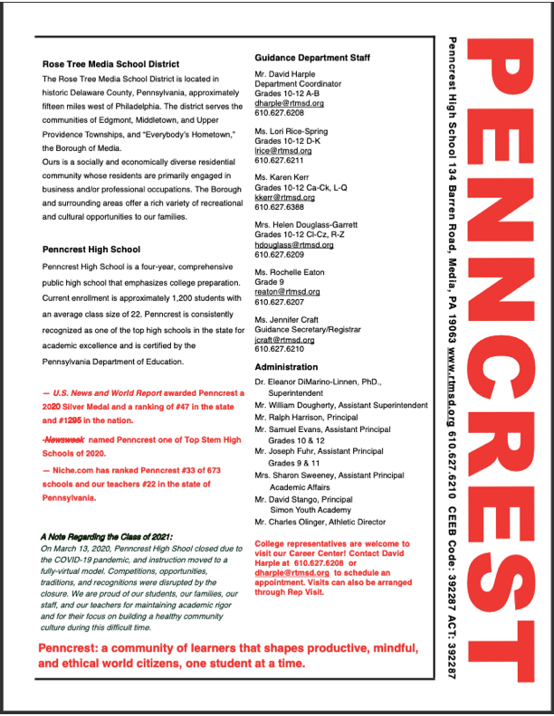

Slide 40
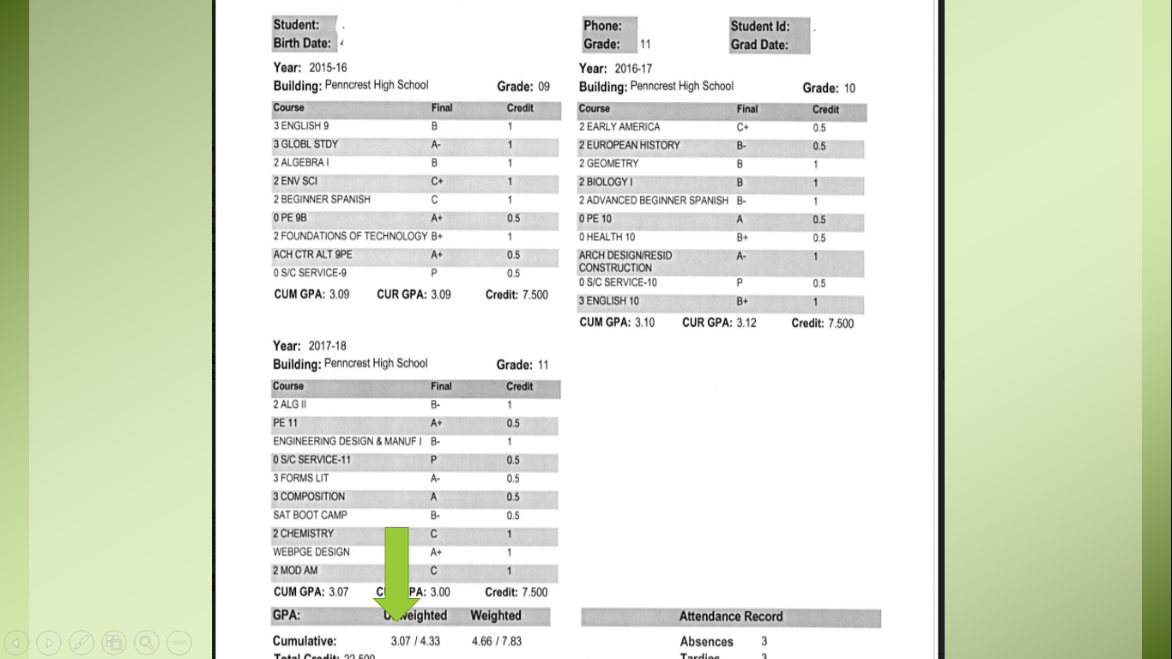

Slide 41
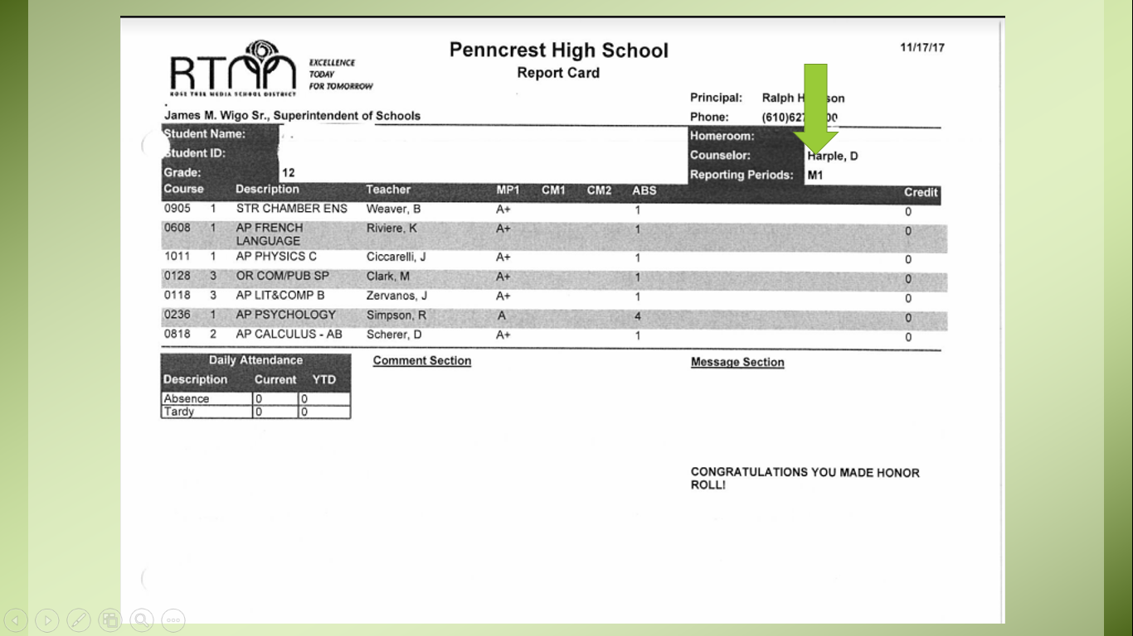

Slide 42
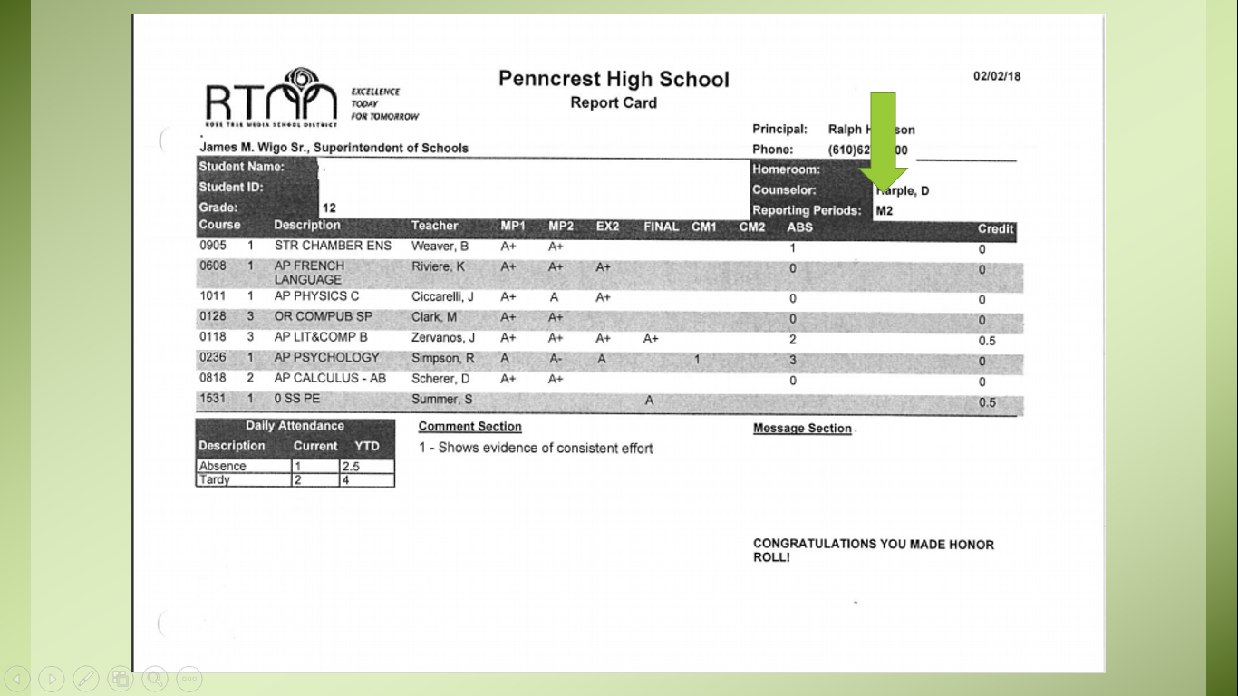

Slide 43
Student Athletes and the NCAA
Understanding the process of eligibility to compete at the next level

Slide 46
Closing Thoughts on College Applications
Work on your applications now. Common App essay prompts are now available.
Send your application when you have completed all of the parts.
Do not wait for school documents. School materials will follow and join your application materials.
Notify your counselor each time an application is sent, even if it is a self-report application.
If you are an athlete register with the NCAA Clearinghouse and notify your counselor.
Understand deadlines, especially for
Check your email for messages from PHS, your counselor and colleges.

Slide 47
Financial Aid
TBD Senior Parent Night / Financial Aid Night
Remember to file FAFSA
Create FSA ID
Remember to check the Financial Aid page for each of your schools. Some schools require the CSS Profile. (Located on the Collegeboard website)
Check the net-price calculator under the financial aid link for each college.
Know your deadlines-especially for financial aid and scholarships

Slide 48
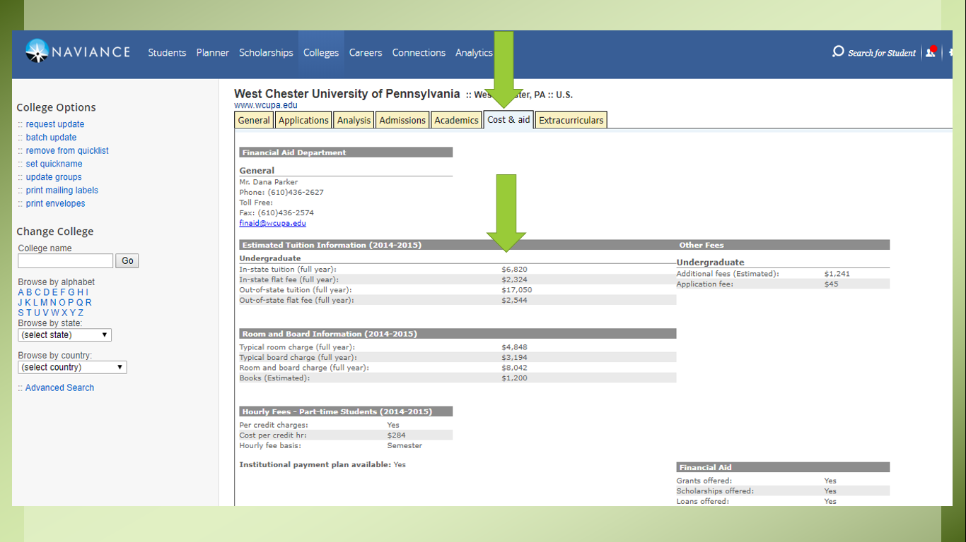

Slide 49
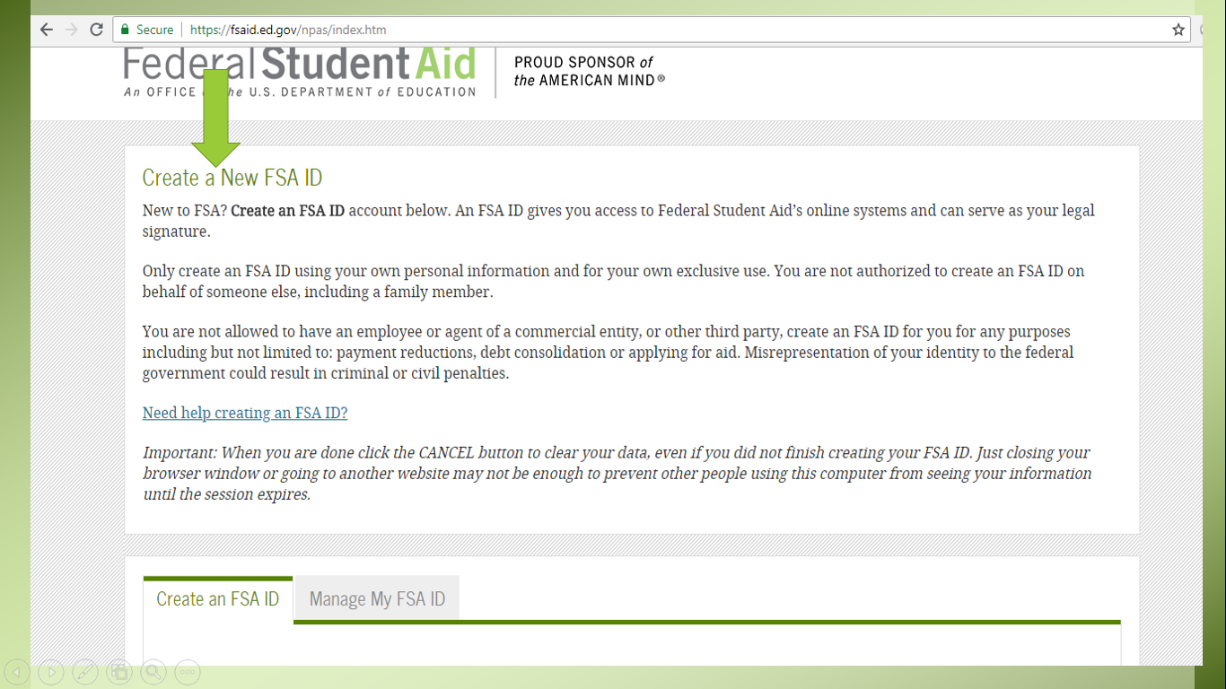

Slide 50
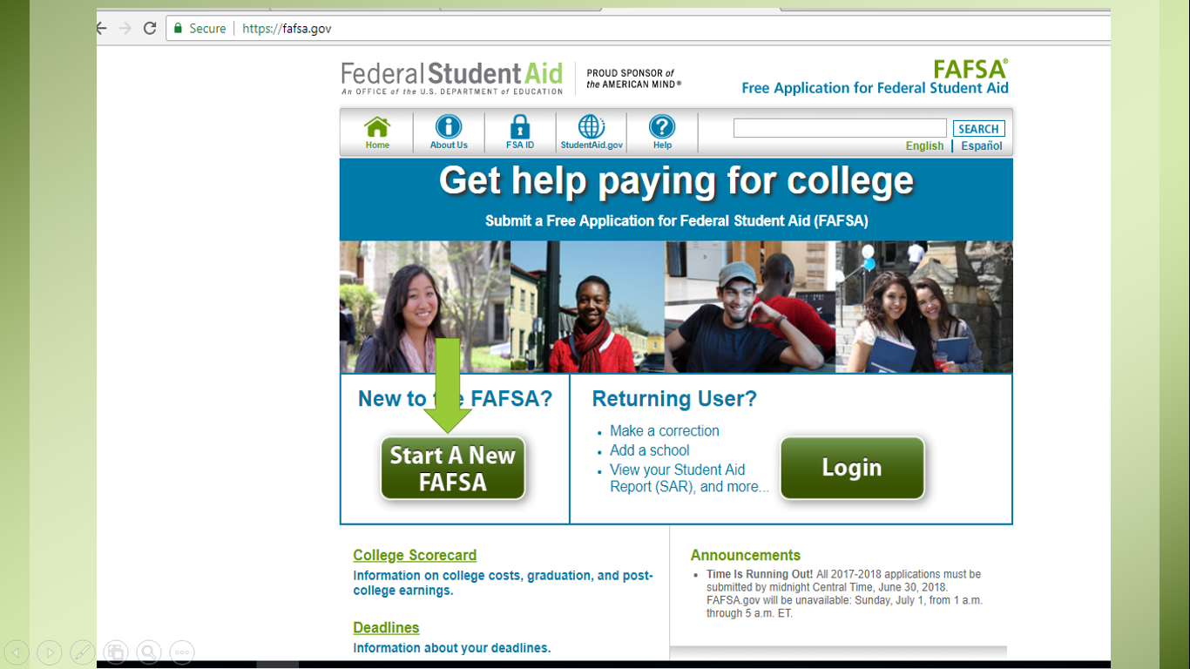

Slide 51
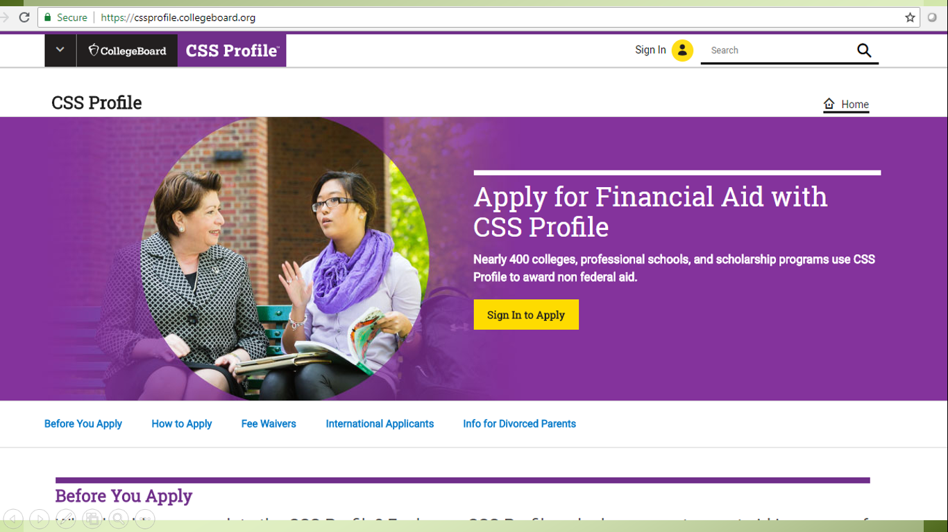

Slide 52
Finally…
Focus on your priorities, needs, goals
Prioritize your time
Stay organized
Ask for help – Counselors, Teachers, Admissions Offices are here to help
Student self-advocacy carries weight

